Slide 1
  Account Object Configuration
Level - Practioner

Slide 2
About the Author
Created By: | Subham Chowdhury, Supriyo Saha
Credential Information: | Associate – Projects, Sr. Consultant – CRM, EAS Salesforce
Version and Date: | V1, 22-Jan-2018, August-2023: Updated with Lightning UI
Modified By: | Ritesh Kumar Prasad ; Srijena, N

Slide 3

Objectives
After completing this chapter, you will learn to:
  Define VEEVA Account record types
  Define custom Accounts fields
  Create custom page layout and record types
  Create a custom Account button
  Display the View User Territory custom link

Slide 4
Recap ...
In the previous Module - My Accounts Configurations, you learnt to:
  Define the My Accounts tab
  Create Views
  Create Lists
  Configure the My Accounts tab
  Hide the Mass Update button
  Configure the Schedule a Call button
  Configure the New button
  Enable New Account Wizard
  Enable Parent Account Wizard
  Use the VEEVA Global Account Search
  Describe My Accounts on iRep
And now ...

Slide 5

Do You Know
Account record types drives the different Business & Person Account flows in VEEVA CRM
VEEVA CRM uses Person Account, but not Contacts
VEEVA CRM incorporates custom business requirements though custom fields, record types, page layouts, buttons, etc.

Slide 6
VEEVA Account record types

Slide 7


VEEVA Account Record Types
Business Accounts
  Hospital
  Pharmacy
  MCO: Managed Care Organization, these companies agree to provide most Medicaid benefits to people in exchange for a scheduled payment.
  Practice
  Wholesaler
  Person Accounts
  Professional
  MD, RN: Doctor of Medicine, Registered Nurse
  KOL: Key Opinion Leaders (KOLs) are experts and advisors that have earned a reputation in their field
  Staff

Slide 8
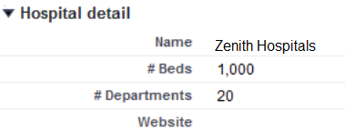
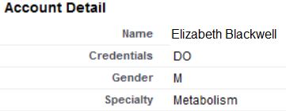
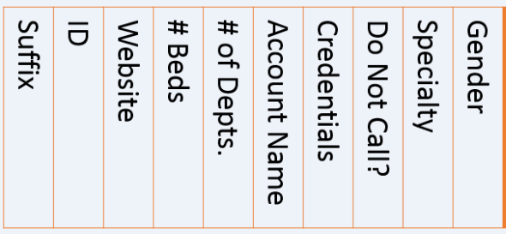
VEEVA Account Record Types Cont...
Hospital Page Layout – Business Account
Professional Page Layout – Person Account
Hospital Record Type
Picklists Segmented for Hospitals.
Professional Record Type
Picklists Segmented for Professionals.
Accounts Object
# Beds
# of Depts.
Account Name
Credentials
Specialty
Gender
Similarly,
#Beds = #Beds
#Departments = # of Depts.
Website = Website
Credentials = Credentials
Gender = Gender
Specialty = Specialty
SFDC Data Storage

Slide 9
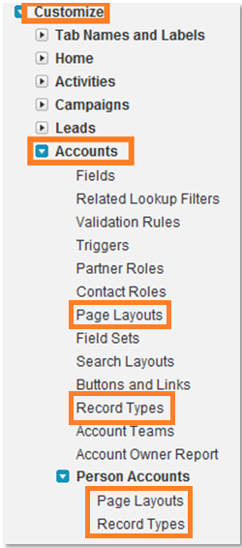
Account Object Configuration
Steps to access the Accounts Object:
  Setup > Customize > Accounts
Common Configuration
  Add custom Account fields
  Add related lists to page layouts
  Add VEEVA s-controls to page layouts
Create custom record types and corresponding page layouts
Best Practice
  Add Record Type field to Account page layouts
Business Accounts:
Hospitals, Pharmacies, MCO, Hospital Departments.
Person Accounts:
Professionals, KOL, Person..

Slide 10
Custom Account Fields

Slide 11
Scenario: Hospital Account Custom Fields ... 1
Users may be required to show a badge when they visit doctors in hospitals
Display on the Hospital page layout:
  Whether a badge is required for a specific hospital
  If the users have a valid badge
Since the Accounts object does not have fields which can be used for this purpose:
  Create the new custom fields
  Place them on the page layout for hospital accounts

Slide 12
Scenario: Hospital Account Custom Fields ... 2
To create custom fields for the Accounts object:
  Setup > Customize > Accounts > Fields
Create the needed custom fields:
  Badge Required – Checkbox
  Badge Status – Pick list (Needed, Active, Expired)
Specify which user profile(s) will have access to the custom fields:
  E.g.: Only System Administrator and Primary Care Sales Management - Platform profiles should have access
Place the custom fields on only the hospital page layout:
  Create a section on the page layout called Badge Info
  Place the badge fields in the Badge Info section

Slide 13
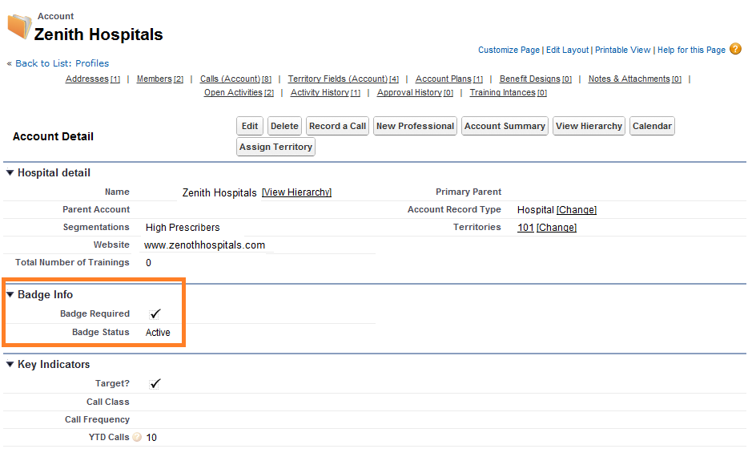
Page: Hospital Accounts Custom Fields
  Badge Required – Checkbox
  Badge Status – Pick list (Needed, Active, Expired)

Slide 14
Custom Page Layouts and Record Types

Slide 15
Scenario: Create a New Record Type
The Organization needs to keep track of interactions users have with staff members such as receptionists for business accounts
Since VEEVA does not have a “Staff” record type and page layout out-of-the-box:
  Create a “Staff” record type and “Staff” page layout

Slide 16
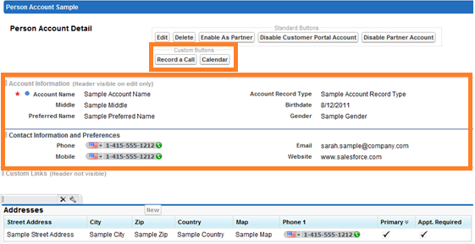
Custom Page Layout
To create custom person Account record type:
  Setup > Customize > Accounts > Person Accounts > Record Type
To create custom person Account page layout:
  Setup > Customize > Accounts > Person Accounts > Page Layouts
Create a page layout called Staff based on the Professional page layout and display the following info:
Create a new record type called Staff based on the Professional_vod record type:
  Enable it only for the System Administrator and the Primary Care Sales - Platform

Slide 17
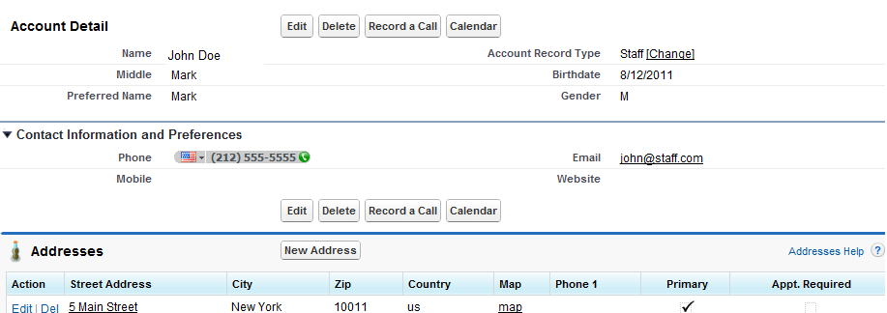
Custom Staff Page Layout
From the My Accounts tab, create a new Staff record
The new custom Staff Account page layout should look like the screenshot below:

Slide 18
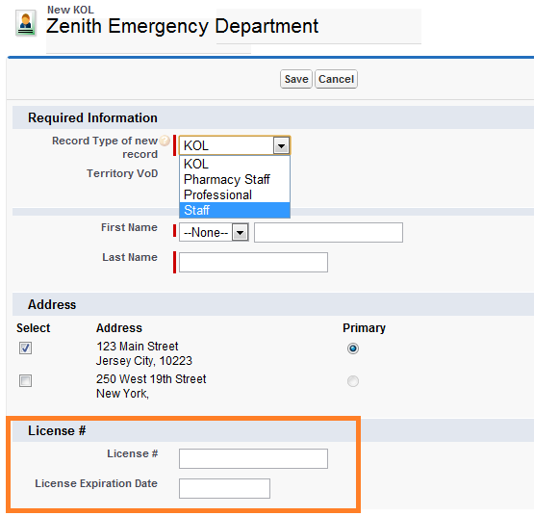
Disable License Number ... 1
When users create a Staff record, the wizard displays a License # section which does not apply to Staff accounts

Slide 19
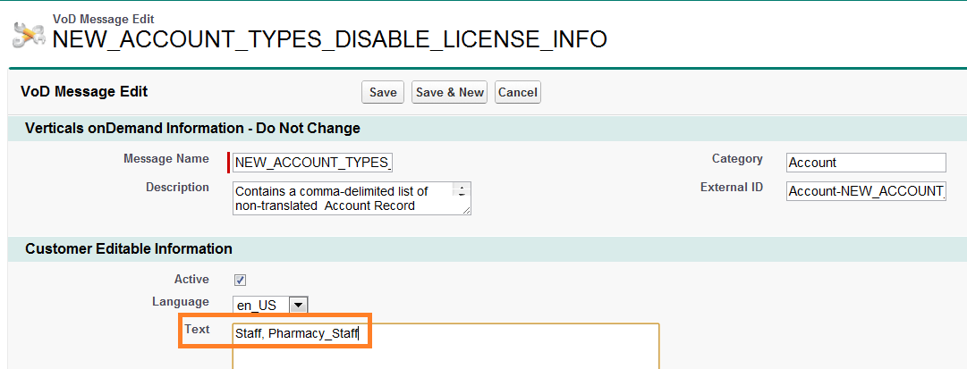
Disable License Number ... 2
To remove the License # section from the Wizard:
  Use custom VEEVA Message:
    NEW_ACCOUNT_TYPES_DISABLE_LICENSE_INFO
  List record types: Staff
  Clear VOD Cache
List record types label
separated by comma

Slide 20
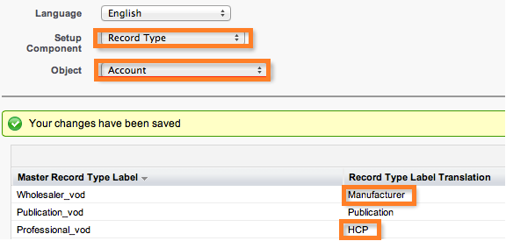
Disable License Number ... 3
Never change the label of out-of-the-box record types directly in the Account object
Use the Translation Workbench to provide custom values for Account record type labels instead
  Go to Setup > Translation Workbench > Translate

Slide 21
Custom Account Button

Slide 22
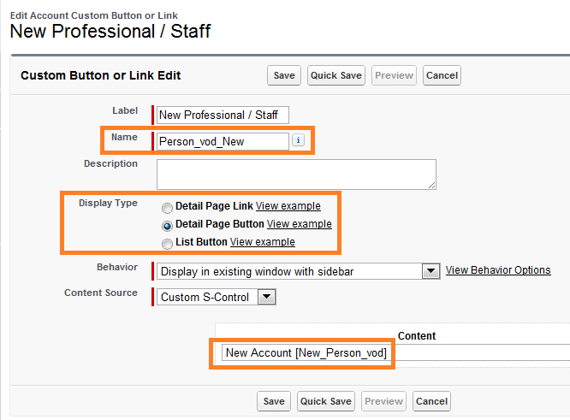
Create a Custom Button ... 1
To create custom button in the Accounts object:
  Setup > Customize > Accounts > Buttons and Links
Create a new button with following information:
The name must begin with a letter and use only alphanumeric characters and underscores. The name cannot end with an underscore or have two consecutive underscores
Display as Detail Page Button
Use the New Account [New_Person_vod]
S-Control

Slide 23
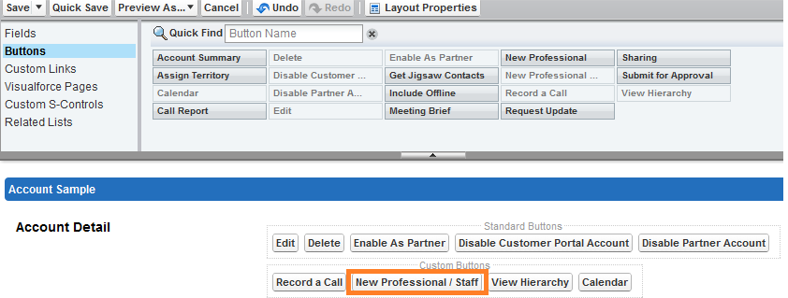
Create a Custom Button ... 2
To place the custom button on the Hospital Department page layout:
  Setup > Customize > Accounts > Page Layouts
  Edit the Hospital Department page layout
  Remove the New Professional button from the page layout
  Place the New Professional / Staff button on the page layout

Slide 24
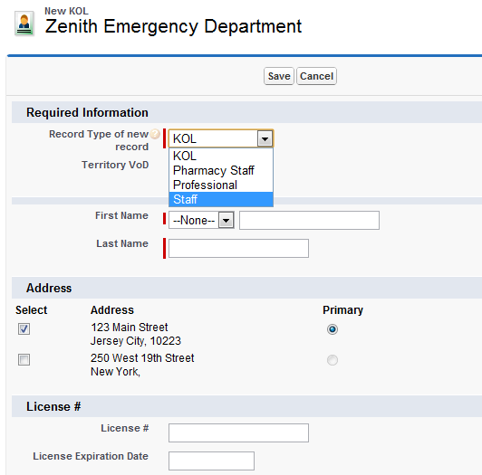
Create a Custom Button ... 3
From the My Accounts tab, go into the Zenith Emergency Department account
Click the New Professional / Staff Button
Since the button uses the New Person Account s-control, the Record Type of new record picklist displays

Slide 25
View User Territory Info

Slide 26
View User Territory Custom Link
Displays all the users aligned to the territory for the account
Modify the needed Account page layout and add the View User Territory custom link under Custom Links
User Profiles need access to User_Territory_vod Visualforce page
  Setup > Develop > Pages > Security

Slide 27
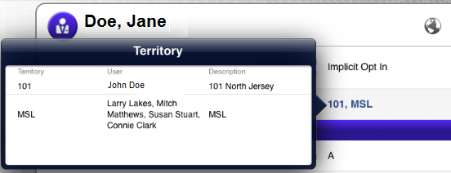
Territory Field
The View User Territory custom link only works online
The Territory field shows territory information for an account on iRep

Slide 28
Check Your Understanding ... 1
1. How to change the label of out-of-the-box record types for account object?
Change the label from setup
Use the Translation Workbench to provide custom values for Account record types lab
Answer: Use the Translation Workbench to provide custom values for Account record types lab
© Cognizant 2015

Slide 29
Check Your Understanding ... 2
2. The View User Territory custom link only works online.
State True or False
True
False
Answer: True
© Cognizant 2015

Slide 30
Check Your Understanding ... 3
3. VEEVA CRM uses Contacts, but not Person Account.
State True or False
True
False
Answer: False
© Cognizant 2015

Slide 31
Check Your Understanding ... 4
4. Custom Query to remove the license # section from the wizard is
NEW_ACCOUNT_TYPES_DISABLE_LICENSE_INFO
NEW_ACCOUNT_TYPES_DISABLE_LICENSE_RECORD
NEW_ACCOUNT_TYPES_DISABLE_LICENSE
NEW_ACCOUNT_TYPES_LICENSE_DISABLE
Answer: NEW_ACCOUNT_TYPES_DISABLE_LICENSE_INFO
© Cognizant 2015

Slide 32
Check Your Understanding ... 5
5. When creating a view, the user must input query criteria. The values for this criteria are case sensitive.
State True or False
True
False
Answer: True
© Cognizant 2015

Slide 33

Summary
Defined VEEVA Account record types
  Business Account
  Person Accounts
  Defined custom Accounts fields
  Place custom fields on specific account page layout(s)
Created custom page layout and record types
Created a custom Account button
Displayed the View User Territory custom link

Slide 34
Coming Next ...
In the upcoming module - Sphere of influence, Affiliation, Account Hierarchy you will learn to:
  Describe Account Affiliation
  Describe and Configure Sphere of Influence
  Describe and Configure Account Hierarchy
© Cognizant 2015
34

Slide 35
  You have successfully completed
  Account Object Configuration

